Slide 1

Abstract Writing

Slide 2


Abstract!
An abstract is a self-contained, short, and powerful statement that describes a larger work.
An abstract is sort of pre-introductory paragraph which provide information about whole research work in strong sentences.

Slide 3

The abstract is an original document rather than an excerpted passage(passage taken from book, document etc.).
An abstract is not a review, nor does it evaluate the work being abstracted. While it contains key words found in the larger work

Slide 4



Writers of Abstracts
Authors
Professional writers

Slide 5
Writers of Abstracts
Most often, the author of the entire work writes the abstract. However, there are professional abstracting services that hire writers to draft abstracts of other people’s work.
In a work with multiple authors, the first author usually writes the abstract.
Undergraduates are sometimes asked to draft abstracts of books/articles for classmates who have not read the larger work.

Slide 6
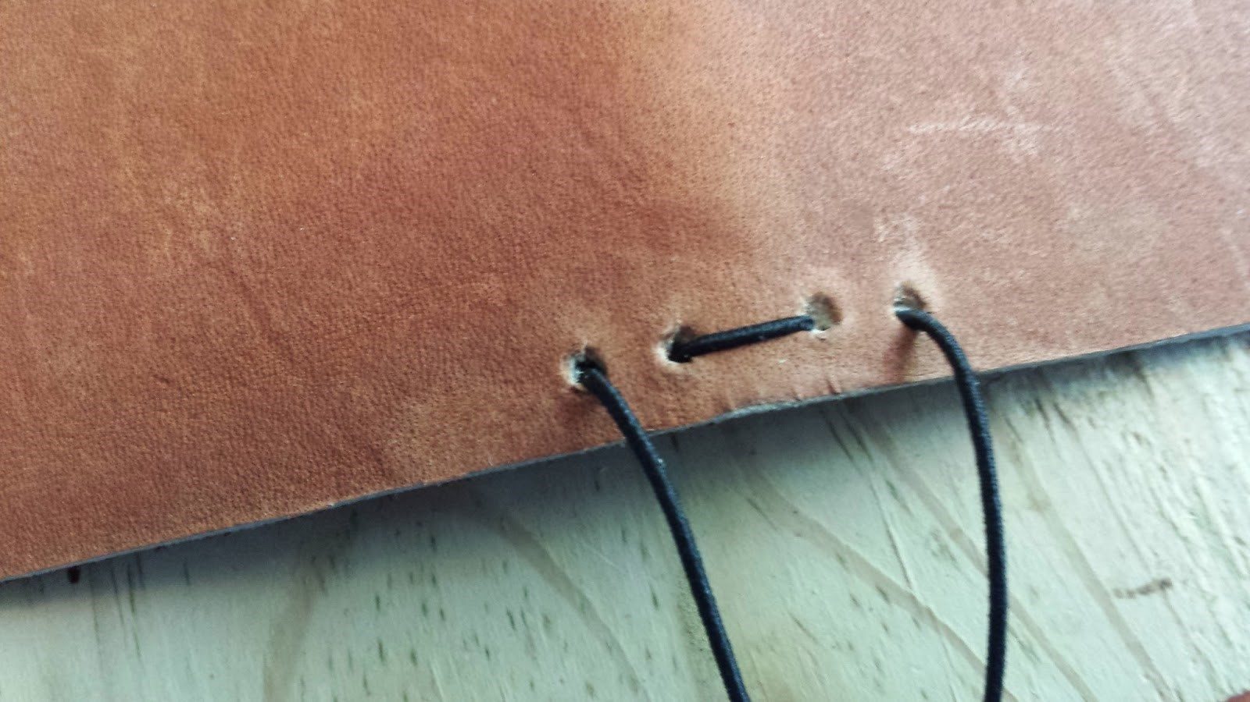

Purpose
To introduce journal articles
To inform readers about the article’s content
To help readers decide whether or not to read article
To overview conference programs, abstract collections, and book chapters

Slide 7
WHY DO PEOPLE WRITE ABSTRACT ?
When submitting articles to journals, especially online journals
When applying for research grants
When writing a book proposal
When completing the Ph.D. dissertation or M.A. thesis
When writing a proposal for a conference paper

Slide 8
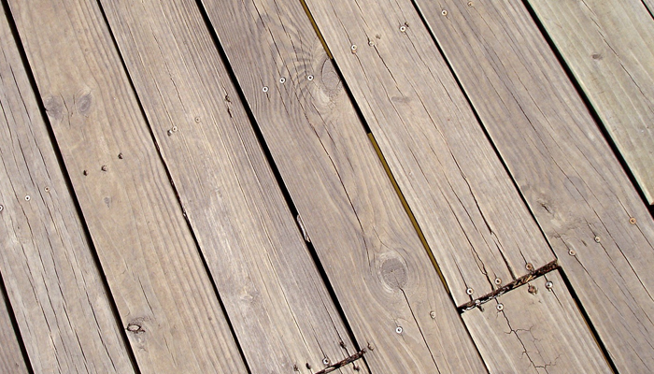


Explanatory Parts
Problem statement
Actuality
Problem solution
Used techniques and methods
Conclusion

Slide 9


To put it simple
WHAT you did?
WHY you did it?
HOW you did it?
WHAT you found?
WHAT it means?

Slide 10


Importance
Helps you present complex information
Helps you read abstracts more effectively
Helps you conduct research
Helps you write abstracts for future publications
Helps you condense report information into a short format

Slide 11



Same-field professionals (e.g. linguists, psychologists, biologists) looking for further information.
Teachers having to evaluate future specialists’ achievements.
Students charting research in a given area.

Slide 12


Components of an abstract
Title
Author
Objective
Methods
Results
Conclusions

Slide 13

Title
It is the first view of your paper
It helps reader to find your paper
It must be small
It develops the reader’s attention

Slide 14

Author
An author is the one who did the research
The advisor is also the author
The additional people who have worked maybe the authors
The author’s name must appear at the beginning

Slide 15
Objective
The purpose for which you did the project
The practical, or artistical, gap your project is filling
It is the motivation
It catches the people attention

Slide 16

Method
Procedure
The steps you took to carry out the research
The way to get the data
The way of getting the required results

Slide 17

Results
What was found or created?
Typically does not include actual data
Distinguish between fact and conjecture
NEVER predict your results!!!

Slide 18

Conclusions
Tells the importance of the research performed
Implication of your research
Helpful for future researchers

Slide 19

Keep in mind
Use limited number of sentences
The result should be stated by restrictions
such as "might", "could", "may“.
Use of keywords and phrases
Use of topic area
Show your main claim

Slide 20
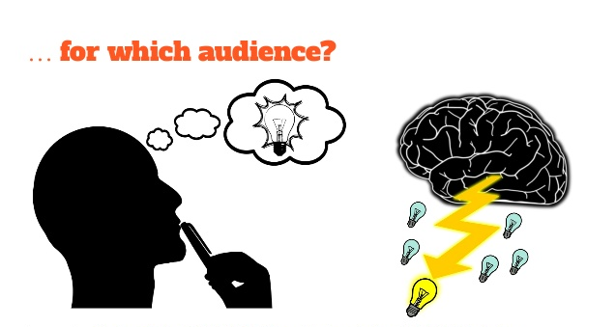
Consider your audience

Slide 21
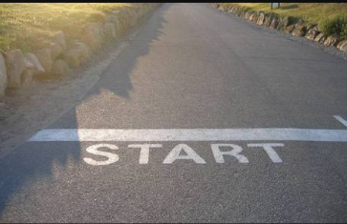
Starting your abstract
Read your paper in its entirety
Underline key points
An abstract usually contain ; topic, method, research questions and results
Create your abstract step-by-step

Slide 22

Step by step process
1-2 introduction sentences
1-2 sentences describing your research methods
1-2 sentences describing the results
1-2 sentences containing your conclusions

Slide 23
Title Author’s name
Purpose or objective of project / experiment: An introductory statement of the reason for investigating the topic of the project. A statement of the problem or hypothesis being studied.
Summarize procedures, emphasizing the key points or steps: A summarization of the key points and an overview of how the investigation was conducted. Omit details about the materials used unless it greatly influenced the procedure or had to be developed to do the investigation. An abstract should only include procedures done by the student. Work done by a mentor (such as surgical procedures) or work done prior to student involvement must not be included.
Detail observations/data/results: This section should provide key results that lead directly to the conclusions you have drawn. It should not give too many details about the results nor include charts or graphs.
State conclusions/applications.
Sample

Slide 24
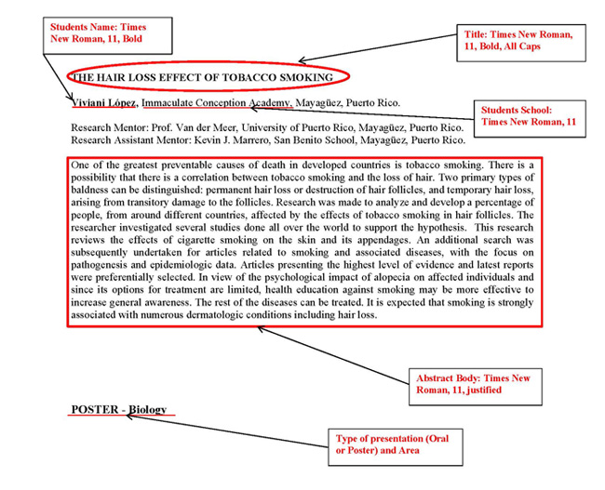

Slide 25
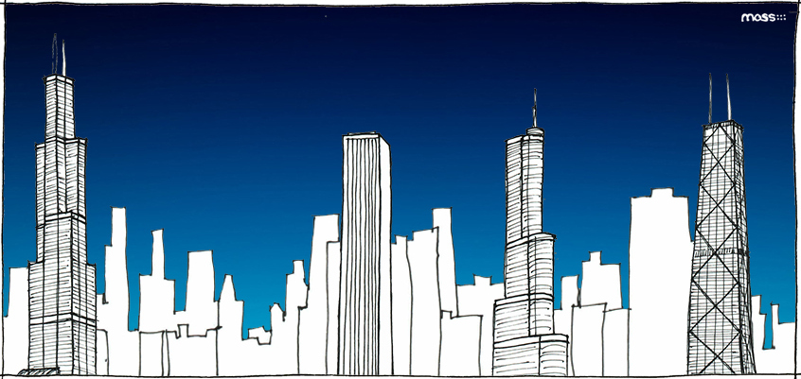
Types of Abstract Writing

Slide 26


Types
1
2
3
4
Descriptive Abstracts
Informative Abstracts
Structured Abstracts
Graphical Abstracts

Slide 27

Descriptive Abstracts
The issues or problems explored.
Very short (100 words)
Not very useful to prospective readers.
What the text is about.
It is an outline of the work, rather than a summary.

Slide 28
Descriptive Abstracts
It makes no judgments about the work, nor does it provide results or conclusions of the research.
It does incorporate key words found in the text and may include the purpose, methods, and scope of the research.
A descriptive abstract indicates the type of information found in the work.
Descriptive abstracts are much easier to write
They require the least thought, effort and specifics!
They are not very useful to prospective readers.

Slide 29

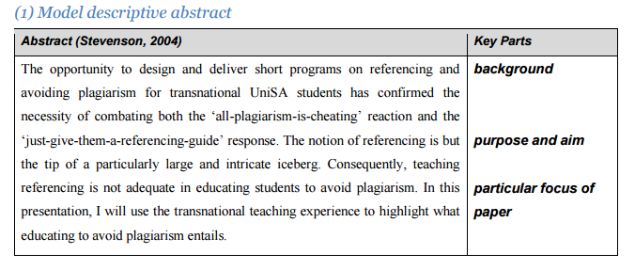
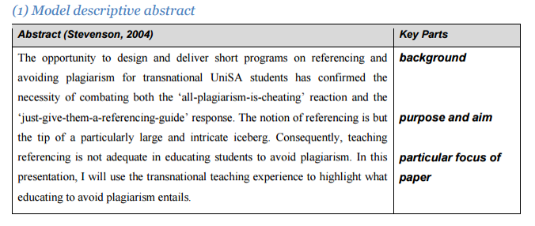
Example

Slide 30


Informative Abstracts
In a good informative abstract, the writer presents and explains all the main arguments, important results and evidence in the complete article/paper/book.
More than 10% of the length of the entire work.
State briefly the content of the paper.
Follow the sequence of the article
Represent each section of the paper
Intro, Method, Results, Discussion
Also possibly Background, Conclusions, Implications

Slide 31
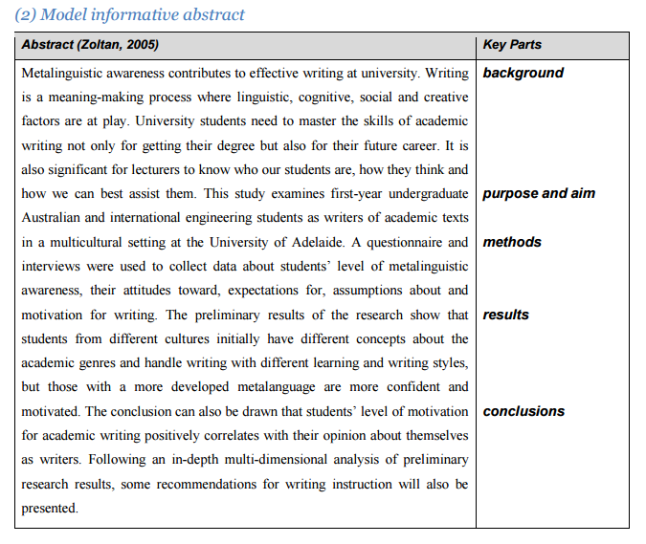
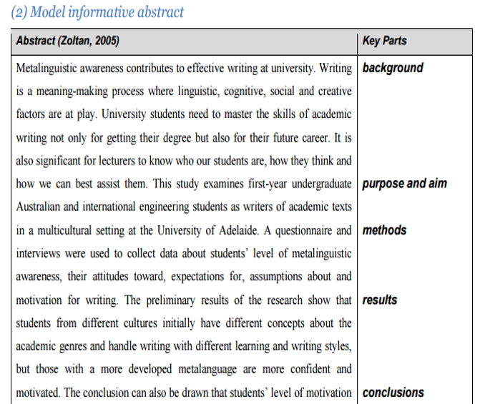
Example

Slide 32
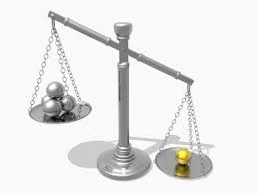
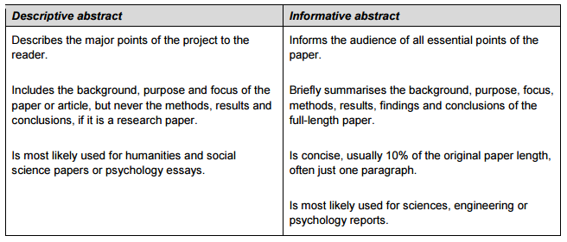
Comparison

Slide 33

Structured Abstracts
It includes brief summary of all main distinct sections.
1
It lists the section titles.
2
In 250 words or less words.
3
More informative abstract.
4
Its order is background, aim, method, results and conclusions.
5

Slide 34
Effective use of color can enhance the graphical abstract
The graphical abstract is one single‐panel image
It gives readers an immediate understanding of message of the paper
The maximum dimensions are 11 × 5 cm (4.3 × 2.0 in.)
Graphical Abstracts

Slide 35

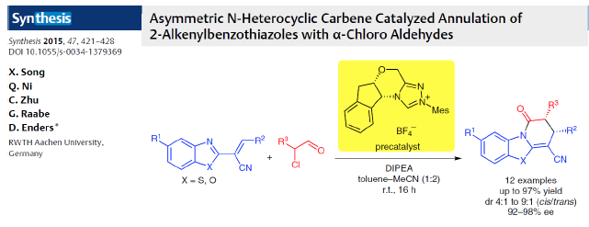
Example

Slide 36
HOW DO I WRITE AN ABSTRACT?
When preparing to your abstract, keep the following key process elements in mind:
Reason for writing:
What is the importance of the research?
Why would a reader be interested in the larger work?
Problem:
What problem does this work attempt to solve?
What is the scope of the project? What is the main argument/thesis/claim?

Slide 37
HOW DO I WRITE AN ABSTRACT?
Methodology:
How did you go about your findings
What steps were taken to carry out the project
Abstracts may describe the types of evidence used in the research.
Results:
Include specific data that indicate the result of the project
Enough detail to make it clear
Other abstracts may discuss the findings in a more general way.

Slide 38
HOW DO I WRITE AN ABSTRACT?
Implications:
What changes should be implemented as a result of the findings of the work?
How does this work add to the body of knowledge on the topic?
Include these implications into your very last sentence

Slide 39


Tips and Hints
Phrases
General tips
Easy to read
Things to Avoid

Slide 40



General Tips
Identify the Problem and Research Solution
Stick to the Word Count
Include Information on Methods and Results
Mention the Implications of Your Research
Overview of the contents of the progress report
Look at examples of abstracts
Don’t add any information that is not in your report or paper
Reveal what's in the article
Review and Update the Abstract

Slide 41


Making the abstract easy to read
Do not use abbreviations without first defining them.
Don't omit articles or other little words in an effort to save space.
Avoid jargon.
Write in the third person singular.
Use active verbs rather than passive verbs.
Use short sentences.
Use complete sentences.

Slide 42


Things to Avoid
Avoid unnecessary phrases
If possible, do not use acronyms
Avoid rephrasing or restating the title
Information not in the original work
References to other work
Quotations from the original work
Lengthy explanations of words and concepts
Tables and maps
Don’t repeat information or go into too much detail.
Don’t just cut and paste sentences from one’s research paper into one’s abstract

Slide 43

Phrases
The paper presents…
It is reported that …
The article deals with…
The paper is concerned with
It should be noted about…
It is spoken in detail about

Slide 44

Revising and Overview

Slide 45
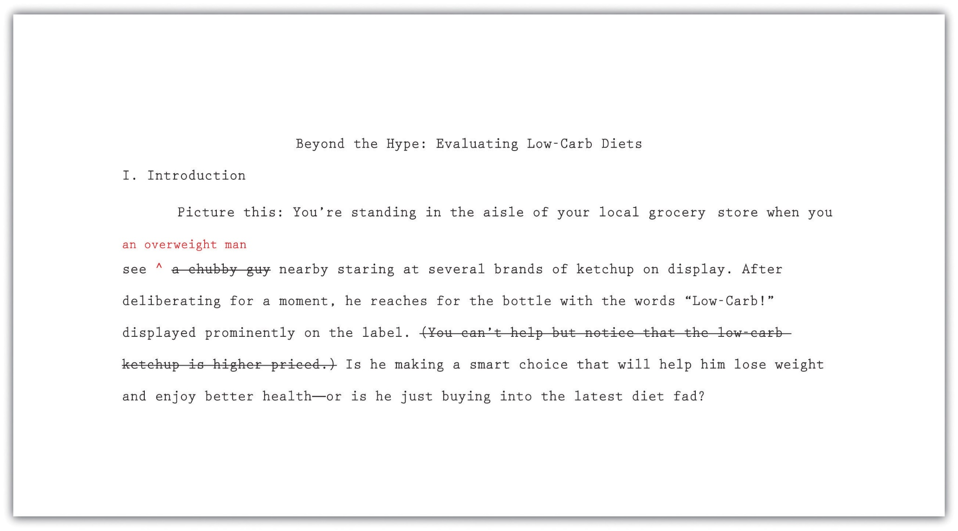

Slide 46
REVISE, REVISE, REVISE
No matter what type of abstract you are writing, the most important step in writing an abstract is to revise early and often.
When revising, delete all extraneous words and incorporate meaningful and powerful words.
The idea is to be as clear and complete as possible in the shortest possible amount of space.
The Word Count feature of Microsoft Word can help you keep track of how long your abstract is and help you hit your target length.

Slide 47

Limitations of Abstracts
The limitations of the study are those characteristics of design or methodology that impacted or influenced the interpretation of the findings from your research.
Always acknowledge a study's limitations.
Always discuss the limitations of your article.

Slide 48
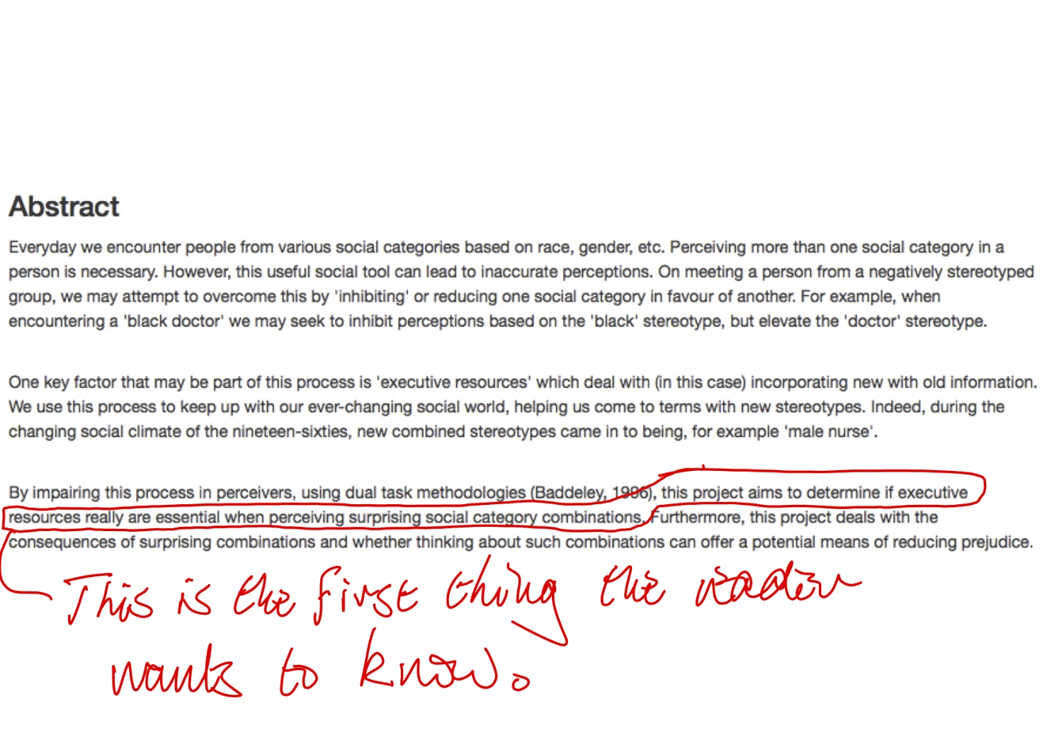
Bad Abstract

Slide 49
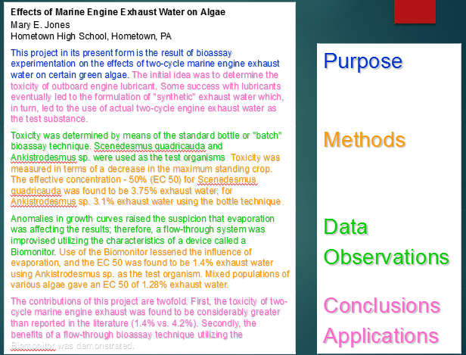
Good Example

